Slide 1

E-Transpo
Team Elite Coders
Team Lead :Chakshu
Team members :Naveen ,Mehak
“The Motive behind this app is to minimize the physical contact to stop the spread of corona virus during commute.”

Slide 2

Basic Instruction
E-Transpo is an android based application.
Due to unavailability of the API we have created just a demo version of it .
Once the API for various railways, buses and metro will be provided , a full fledged app that can handle all three important public transports can be developed.

Slide 3
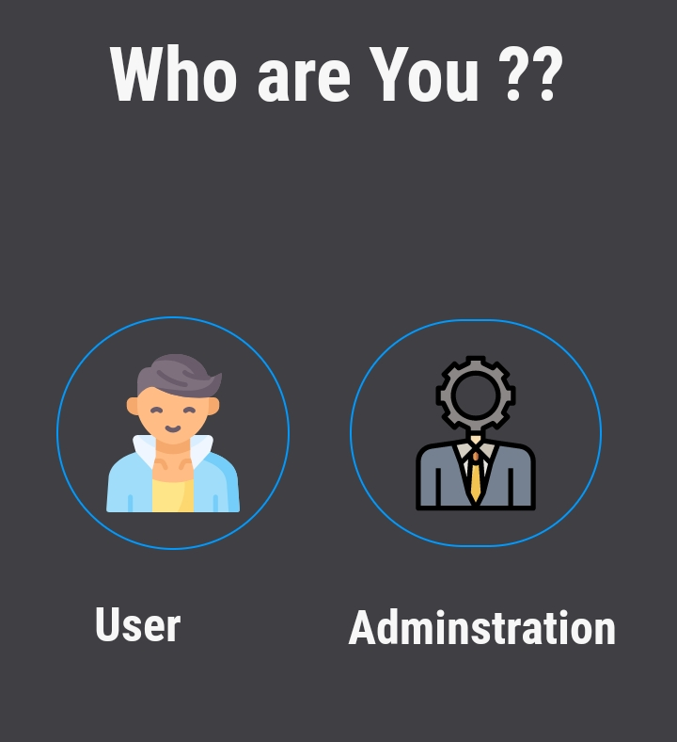
Nucleus Of The Project
Place your screenshot here
It is a dual interface app. One phase is constructed for users and other is for staff members.

Slide 4

Prominent Features of The App
Health + Feature
Bar Code Reader
Restriction On Numbers Of Tickets

Slide 5

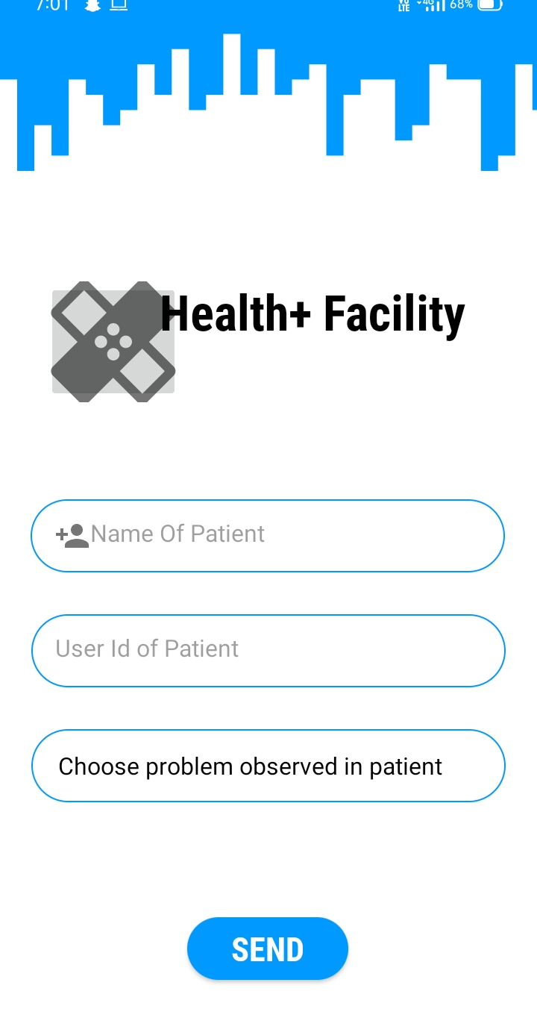
Health + Feature
A special feature named as ‘Health+’ makes this app unique and attractive. This feature helps the user to submit any health issue faced during journey. The information would be immediately reported to staff members to treat the user accordingly.

Slide 6

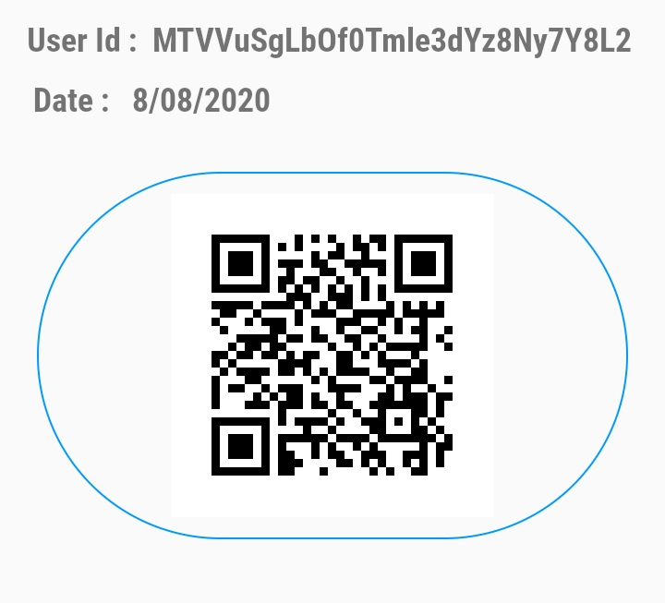
Bar Code Reader
This app has inbuilt barcode scanner that can be used to verify the passengers by the staff member.
When you will book a ticket, a PDF for ticket confirmation with a unique barcode will be generated.
Any staff member can check the credibility of the passenger just by scanning his/her ticket from his/her phone.

Slide 7

Restriction on Numbers of Tickets
An algorithm is set according to which a limited number of seats will be available to follow the idea of social distancing.
Calculated Seats (C.S) =0.5225*Total no. of seats available

Slide 8

Services Used For Development
Firebase Services
Material Designs
Android Studio

Slide 9

We got an astounding chance to learn throughout this journey , from making documentation to working on the app, this journey proved to be amusing and fully knowledgeable.
We will be highly delighted if our app will help the country in the need of hour.
Post Lockdown management of the public transport will be a huge issue in the upcoming time, with the successful development of this app we can manage the crowd in all the public transport without any hotchpotch. Thank You

